Slide 1

Starter: This word spells “fish” if you follow some rules in English spelling. Can you figure out how?
Ghoti

Slide 2
Year 9 English
Assessment Feedback and Reflection: Analysing an opening for ‘The Bridge’
You will need:
Your assessment
A green pen
A range of different colours or highlighters
Plan for today’s lesson:
First impressions of your work
Self-assessment against success criteria
Mr. Glanz’s Feedback
Addressing action targets

Slide 3
First impressions of your work
It’s been two school weeks since the common assessment, so we need to begin by refamiliarising ourselves with the task and our responses. I will now give back your work with just comments - no score or grade. Take 5 minutes to read over your work to form a first impression.
Ask yourself:
Does your analysis respond to task?
To what extent does this analysis reflect the quality you expect from your work?
What impresses you? What are you proud of?
What would you want to change?
Task:
“Read five story openings for the ‘The Bridge’. Select ONE opening passage and analyse how/why it is an effective way to begin a narrative.”

Slide 4
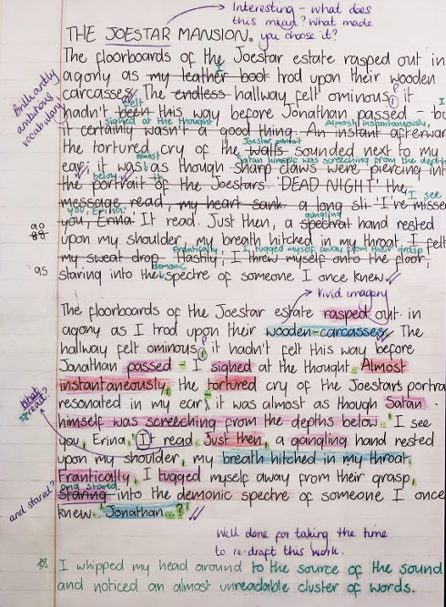
What might meaningful self-assessment look like?
As well as:
responding to pink-pen teacher comments
identifying what is a ‘missed opportunity’...
…and what is a ‘gap’
green-pen editing
redrafting
self-assessing for skills against the success criteria

Slide 5
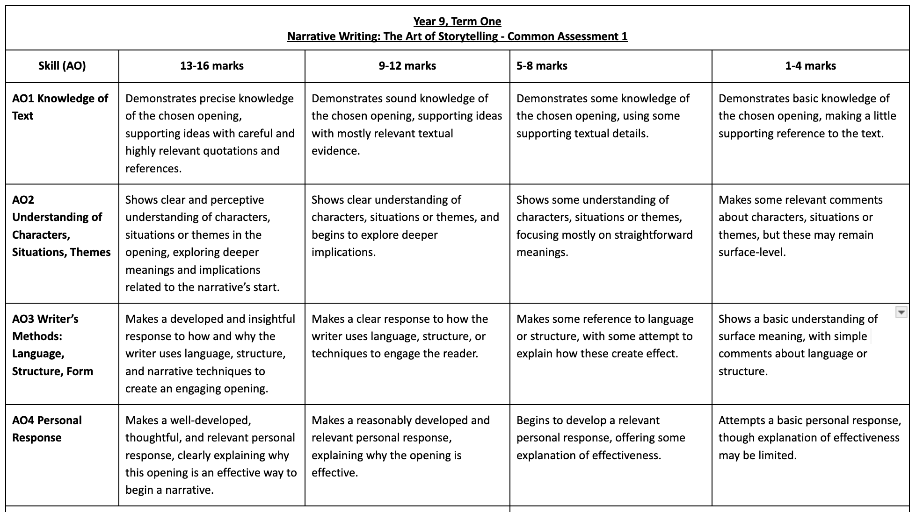
The success criteria:
AO1: Using evidence AO2: Deeper understanding of the text AO3: Author technique AO4: Reader response

Slide 6
Mr. Glanz’s Feedback
Normally, I would “summarise” the class’s strengths and areas for development… but this was not possible. This is not a bad thing…
… It does mean that you will need to pay extra attention to your individual feedback.
Observations:
Sometimes, opinions were justified well, but used no evidence from the text.
Sometimes, evidence was used, but techniques were not pointed out.
Sometimes, evidence was used, but not in relation to the overall question.
Everyone completed the task on time, however. Well done.
In other words, strengths and weaknesses were “all over the place.” Very few students addressed every AO (assessment objective).
As a group, you need to make sure your work is “the whole package.”

Slide 7
Mr. Glanz’s Feedback
Strengths:
Task was generally understood well
Range of evidence cited
Some techniques correctly identified
A few students with some very good insights.
Areas for development:
A lot of vague phrasing, e.g. “this makes opening C effective,” or “this makes the reader curious and want to read on.”
Not always “the best” evidence chosen for points.
Points chosen not always connected to why they are examples of something that is enjoyable.
Paragraph structure!!

Slide 8
Mr. Glanz’s Feedback
An observation:
Something a little worrying that stuck out was that very few of you seemed to actually engage with the texts, the characters, what they were experiencing, and what was actually going on.
I feel that there was very little ‘feeling’ in your writing, because perhaps not many of you genuinely felt that any of the openings were interesting or engaging.
If this is the case, consider why someone else might react to the text and what is happening in it.
The only way to improve this ‘organically’ is to read more books, and learn to enjoy reading.

Slide 9
Response to feedback:
Using a green pen, go through my annotations, and respond to at least two (use sticky notes if space is hard to find).
Please do not just write “okay,” “thanks,” or “noted;” instead, choose from this possible “menu:”
To improve this, I will…
I now realise that…
An example of this change would be…
I disagree because…
Next time I write, I will…
Bonus - write me a specific question at the end underneath my generic comment.
If you are finished in under 10 minutes, then feel free to respond to more feedback.

Slide 10
Model Example
The writer of Example A creates an engaging opening by presenting a character, the boatman William J. Swift, as person with uncertain morals. Through the exposition, we are introduced to Brownsville, a place that has transformed from a small settlement to ‘a town of nearly a thousand people’, where the construction of a bridge means that ‘boatmen soon weren’t needed’. The contrast between the modernisation of the setting and a character ‘in his sixties’ who is the ‘only’ boatman remaining, creates an impression of William as a man forgotten by time because it seems as if he is unable to keep up with the world that is changing around him. The writer employs ‘show, don’t tell’ to suggest that William’s experiences have made him both angry and desperate: he is ‘bitter’ about being forced to work ‘any time of day or night’ to earn a basic living, sometimes even agreeing to conceal individuals who ‘didn’t want to be seen publicly crossing the bridge.’ This is an engaging way to open a narrative because the writer deliberately makes it difficult for us to know how to respond to William, making him an unconventional protagonist. By conveying William’s struggles, we are on one hand encouraged to feel sympathy - he is getting older but running out of options to support himself. On the other hand, we are also shown that William is prepared to exploit people who have secrets, or something to hide, for his own personal gain.
The writer of Example A creates an engaging opening by describing a character who is going to be important to the story. We find out that the boatman called William J. Swift is old but strong and has made money over the years by transporting people across the river. But he is the only boatman left because the bridge means that they are not needed anymore. This makes me wonder what the boatman will do to make money in the future because he is getting older but still needs to support himself. We are told by the writer that the boatman is not happy about losing his business, which could mean that he is angry and will do something extreme because he is frustrated about how his life has changed.
Notes:
Two examples - low and high quality responses. Live model how to self-assess against the success criteria, including how to ask questions of one’s own work in order to scrutinise it effectively.

Slide 11
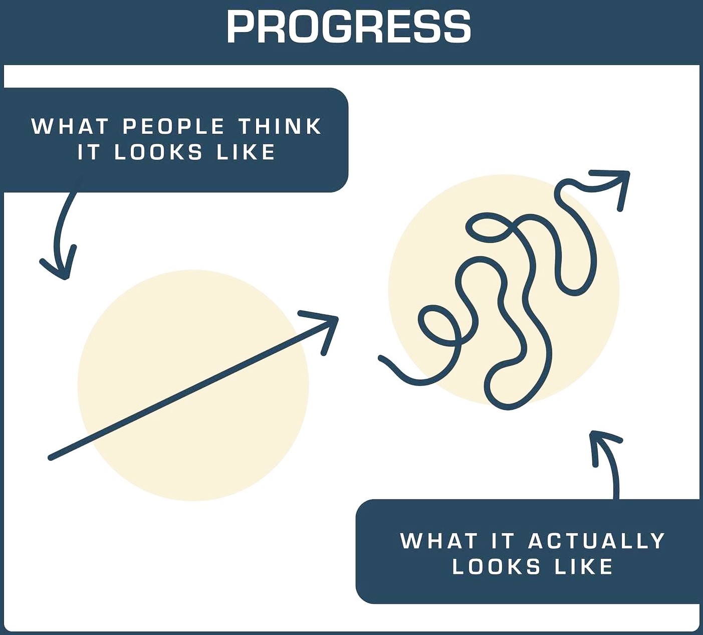
Grade Boundaries
Remember!
This works represents one snapshot of your learning journey, which is very much underway. The question to ask is not ‘What grade did I get?’. The grade only tells you how you did on that day, and does not tell you what you have done well and how to do even better.
Instead, ask yourself ‘What do I know now, and what can do now, that I didn’t 7 weeks ago? What will I do differently next time?’
It’s by asking these questions that you will ensure you continue to make meaningful progress during your time at St. Joseph’s.
A = 12-16
B = 10-11
C = 8-9
D = 6-7
E = 4-5
F = 2-3
G = 1

Slide 12
Have another go!
If you have any spare space on your paper, choose one out of these two tasks, based on your action targets:
Choose a paragraph to rewrite based on what you’ve learned today.
Add another paragraph containing something you didn’t address during the CA.
If you don’t have space, please get some lined paper from the top of the filing cabinet. You’ll staple this to your assessment.
(Green pen)

